Slide 1
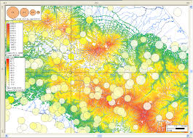
Outline
Important requirement for GIS is to display numerous geographical objects onto display window.
Spatial indexes like R-tree variants are particularly efficient for a range of queries are not adequate to generate large aps with different scales.
Solution – Multiscale R-tree that allows retrieval of geometric objects at different levels of detail.

Slide 2
Scale
Each map has a scale, which is a ratio of distances represented on a map to their true lengths on the Earth’s surface. For example, 1:25000 indicates that a unit of a distance on a map corresponds to 25000 of the same unit on a ground.
Displaying too many objects will reduce the user’s effectiveness in receiving relevant information.
In a small scale map, a polyline with several hundred segments may occupy only a pixel on the display, but the system will retrieve all these segments from the secondary storage and then draw them onto the screen.

Slide 3
Problems
This is not only a waste of CPU time, but also results in many useless secondary disk accesses.
This problem becomes more severe for applications where the data set is large and the map is viewed in real-time.
It is important to have a spatial index that can efficiently store, retrieve and display geometric objects at different levels of detail. These types of index structures are known as reactive data structures.
One possible solution is to store the same map in different scales. Thus, a geometric object will be stored as multiple copies in a database; each with a different level of detail. This method not only introduces a high degree of data redundancy, but also has the potential problem of update anomaly.

Slide 4
Techniques
Two generalization techniques is cartography – simplification and selection
Selection means that unimportant objects on the scale will not be retrieved, simplification means that the display of an object will be shown sufficiently, but without unnecessary details.
Major problem for Multi-scale R-tree is the decomposition of geometrical objects required by the simplification technique.

Slide 5
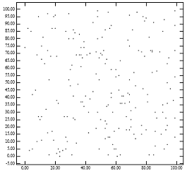
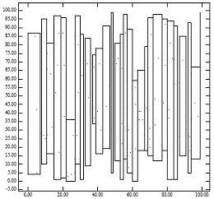
Solution
Design and implement a Multi-Scale Hilbert R-tree
Figure 1: [Left] 200 points uniformly distributed; [Right] MBR of nodes generated by the ‘lowx packed R-tree’ algorithm

Slide 6
Multiscale R-tree
An Ms R-tree shares the same indexing structures as its R-tree counterpart
The main difference is that geometric objects in an Ms R-tree are decomposed and stored as one or more sub-objects in the main data file but without any data duplication.
However, a major problem with this approach is how to decompose objects in the main data file. To investigate this problem, a Multiscale (Mr) Hilbert R-tree is designed and implemented.

Slide 7
Design
A reactive data structure is defined as a geometric data structure with detail levels, intended to support sessions of a user working in an interactive mode
An Ms R-tree is a spatial index as well as a reactive data structure
Works that are particularly related to this design includes Douglas–Peucker line simplification algorithm , BLG-tree, Reactive-tree and PR-file.

Slide 8
Douglas–Peucker algorithm
Another alternative is to store geometric objects in their entirety as usual, and apply a line simplification algorithm to obtain the desired scale.
This is certainly a more efficient method than the previous approach, as the system needs to store only one copy of the geometric object, which avoids the problem of update anomaly.
The Douglas–Peucker line simplification algorithm is used to reduce the number of points needed to represent a numerically recorded line, while at the same time, preserve the important features in the original line.

Slide 9
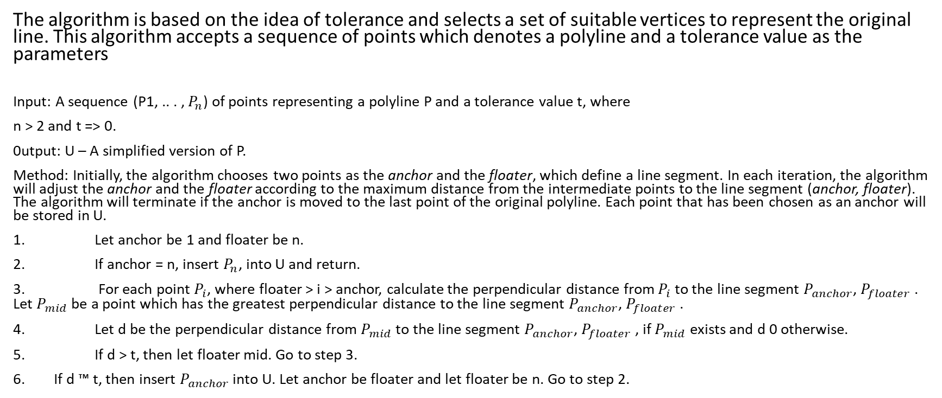
Douglas–Peucker algorithm(P, t, U)
The algorithm is based on the idea of tolerance and selects a set of suitable vertices to represent the original line. This algorithm accepts a sequence of points which denotes a polyline and a tolerance value as the parameters
Input: A sequence (P1, .. . , ) of points representing a polyline P and a tolerance value t, where
n > 2 and t => 0.
0utput: U – A simplified version of P.
Method: Initially, the algorithm chooses two points as the anchor and the floater, which define a line segment. In each iteration, the algorithm will adjust the anchor and the floater according to the maximum distance from the intermediate points to the line segment (anchor, floater). The algorithm will terminate if the anchor is moved to the last point of the original polyline. Each point that has been chosen as an anchor will be stored in U.
1. Let anchor be 1 and floater be n.
2. If anchor = n, insert , into U and return.
3. For each point , where floater > i > anchor, calculate the perpendicular distance from to the line segment , . Let be a point which has the greatest perpendicular distance to the line segment , .
4. Let d be the perpendicular distance from to the line segment , , if exists and d 0 otherwise.
5. If d > t, then let floater mid. Go to step 3.
If d ™ t, then insert into U. Let anchor be floater and let floater be n. Go to step 2.

Slide 10
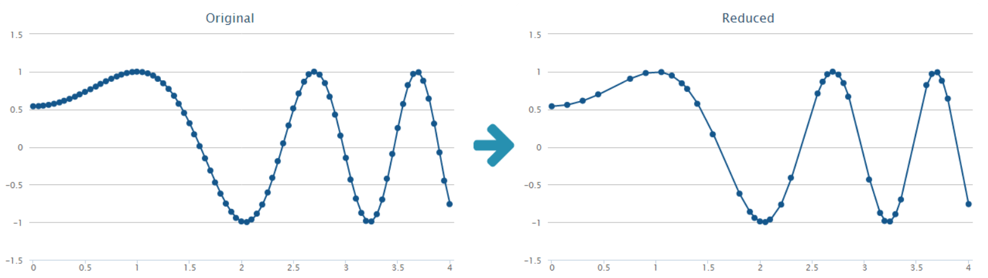
Douglas–Peucker algorithm
The first and last points of P are always in the simplification. The important property of the simplification v generated for a tolerance t is that given a point p in the original line, there is a segment q in v such that the perpendicular distance of p from q is less than t. This simple algorithm turns out to be very effective.

Slide 11
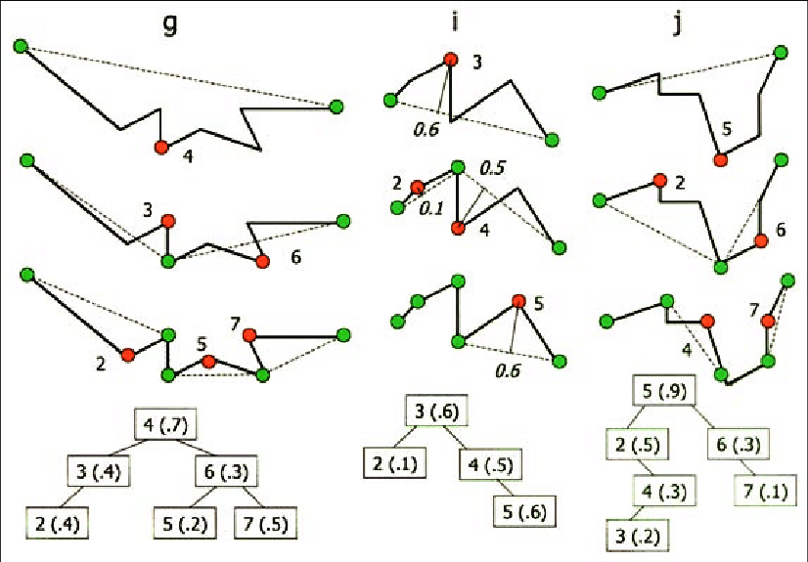
Binary-Line Generalization tree
In a database environment where an object may be retrieved numerous times with different tolerances, repeated computations on an object to obtain a simplification may be too inefficient. The Binary-Line Generalization tree (BLG-tree) was developed to overcome this problem
The idea behind this data structure is to store the result of simplification on a geometric object in a binary tree. Consequently, no application of line simplification is required once the tree is constructed for an object, no matter how many times the object is retrieved and displayed.

Slide 12
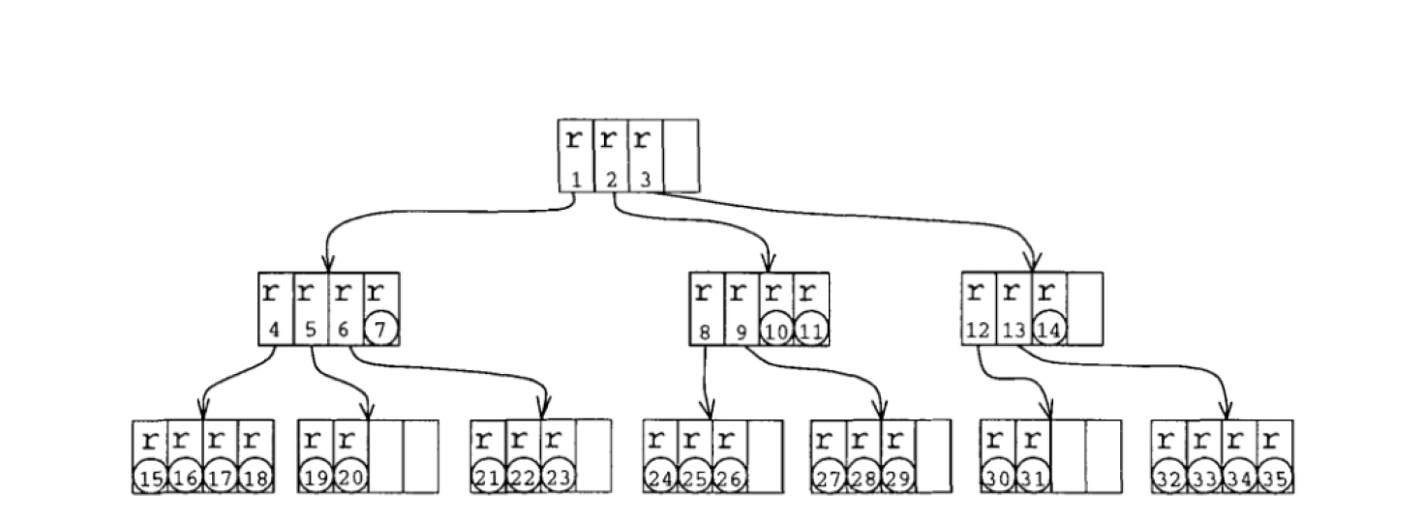
Reactive Tree
A Reactive-tree assigns an importance value to each geometric object, and each object will be stored in a level according to its importance value. It represents the smallest scale map in which the geometric object is still present. During searching, the tree will only retrieve those objects of high enough importance.
Like an R-tree, a Reactive-tree is a multi-way search tree, where each node contains a number of entries. Each node corresponds to one physical disk page.
Entries are of two types: object entries and tree entries. An object entry has a minimum boundary rectangle (MBR), an importance value, and an object id. An object id is a reference to an object, and an MBR is the smallest axis-parallel rectangle that bounds the object. The importance value is the importance of the object that is referred to by the object entry.

Slide 13
Priority Rectangle File
The Priority Rectangle File (PR-file) was designed to efficiently store and retrieve geometric objects in arbitrary scales. Unlike the Reactive-tree, an object in a PR-file is not stored as an atomic unit.
The PR-file makes use of a line simplification algorithm, which will select some of the line segment endpoints from a polyline according to the desired scale.

Slide 14
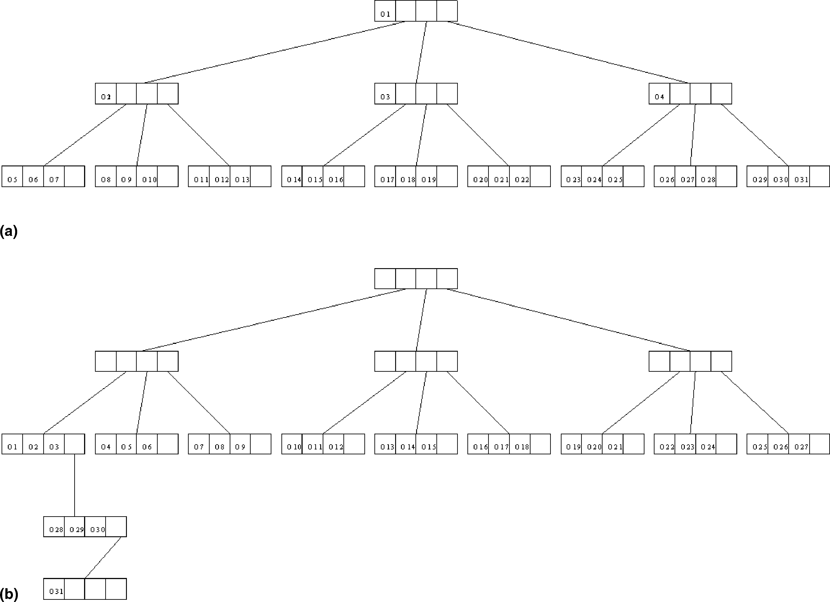
Priority Rectangle File(PR file)

Slide 15
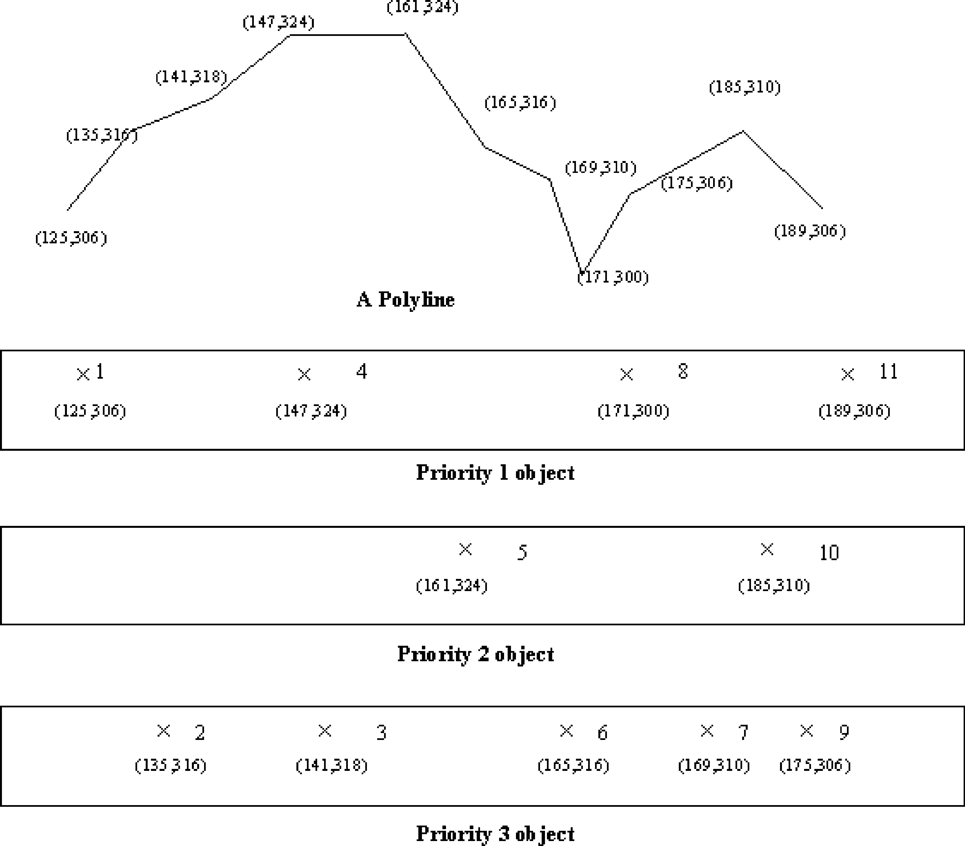
Priority Rectangle File(PR file)
In a PR-file, geometric object is broken into multiple objects and each object is assigned with a priority value. Each priority value corresponds to a map scale. For each scale, objects which have a higher priority values than the priority corresponding to the map’s scale will not be retrieved.

Slide 16
Multi-scale Hilbert R-tree
Hilbert R-trees have an advantage over other R-tree variants in its ability to cluster objects well in a 2D space
The partitioning and the total ordering enable e@cient retrieval of points to generate a simplification based on a given resolution. The term verolution here refers to the units per pixel when displaying a map onto a screen.
Advance Douglas-Peucker algorithm is used in this case.

Slide 17
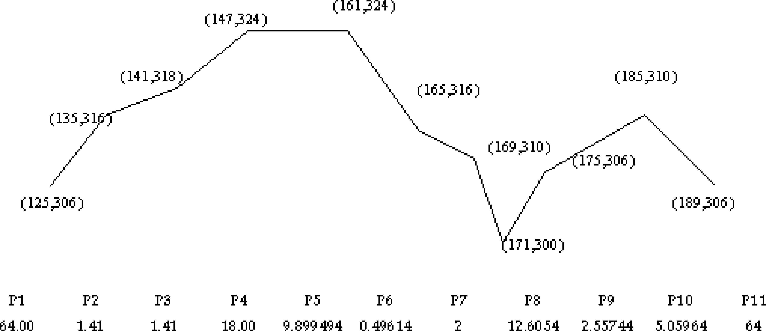
MDP Algorithm
We are primarily concerned with three kinds of geometric objects: points, polylines and polygons. A point is denoted by x, y while a polygon and a polyline are represented by a sequence of points in the form u_{l}, u₂, u₃, .. . , u_{n} . The position of a point in a polygon or polyline is called its sequence number.

Slide 18
MDP Algorithm
Algorithm MDP P, D, s, e, p
Input: A sequence Pl, .. . , Pn of points representing a polyline P. D is the array storing the computed tolerance for each point in the sequence. When this is called, D s and D e have been computed. We want to compute the tolerance values for those points in-between Ps and Pe. p is the maximum perpendicular distance from the previous call.
0utput: An array D which stores the largest tolerance values from which the points in P will be selected.
Method: The algorithm will recursively divide a polyline into two pieces by the point which is the furthest away from the segment Ps, Pe . If Pi is the point which is the furthest away from the line with a perpendicular distance of dis, D i will be the lesser value of dir and p.
l. For each point, Pi, where s > i > e, calculate the perpendicular distance from Pi to the line segment Ps, Pe .
2. Let Pmid be the point which has the greatest perpendicular distance dir to the line segment
Ps, Pe .
3. Let D i min dis, p and set p min dis, p .
4. If mid > s l, call MDP P, D, s, mid, p .
5. If mid c e l, call MDP P, D, mid, e, p .
6. Return.
For a polyline P, the first and last points are assumed to be the most important and are drawn whenever P is displayed. The tolerance value assigned to these two points is the maximum distance max between any pair of points in the sequence. The tolerance values for other points are computed by calling MDP P, D, l, n, max , where P is assumed to have n > 2 points.
Given a tolerance t, the simplification v returned by the MDP algorithm consists of those points Pi such that D i “ t. If t > max, no point is returned by the MDP algorithm. This is diferent from the Douglas–Peucker algorithm where the first and last points are always re- turned. If t ™ max, r enjoys the same property as the simplification returned by the Douglas– Peucker algorithm.

